Slide 1

Bank Customer Segmentation
Presented By -
L. NANDINI
R. SINDHU

Slide 2
Agenda (This should be the PPT flow)
Introduction to Bank Customer Segmentation
Dataset Overview
Data Preprocessing
Exploratory Data Analysis
Customer Demographics Analysis
Transaction Behavior Analysis
Customer Segmentation
Customer Profitability Analysis
Conclusion

Slide 3
Project Overview
Introduction
Bank Customer Segmentation is a data analysis project that examines customer demographics
and transaction behavior using banking transaction data. The analysis helps identify customer
segments, understand spending patterns, and evaluate customer profitability using Power BI.
Objectives
To analyze customer demographics such as age, gender, and location.
To study transaction patterns, frequency, and transaction amounts.
To segment customers based on their transaction behavior and RFM analysis.
To analyze customer revenue, account balances, and profitability across different segments.

Slide 4
Understanding the Dataset
The dataset contains information about bank customers and their financial transactions. It includes 1,048,567 transaction records with customer demographics, account information, and transaction details.
Features include:
Transaction_id
Customer_id
Customer_DOB
Cust_gender
Cust_Location
Cust_Account_Balance
Transaction_Date
Transaction_Time
Transaction_Amount(INR)

Slide 5
Data Preprocessing
Raw Data
↓
Missing Value Handling
↓
Data Cleaning
↓
Data Type Conversion
↓
Feature Engineering
↓
Feature Selection
↓
Prepared Dataset

Slide 6
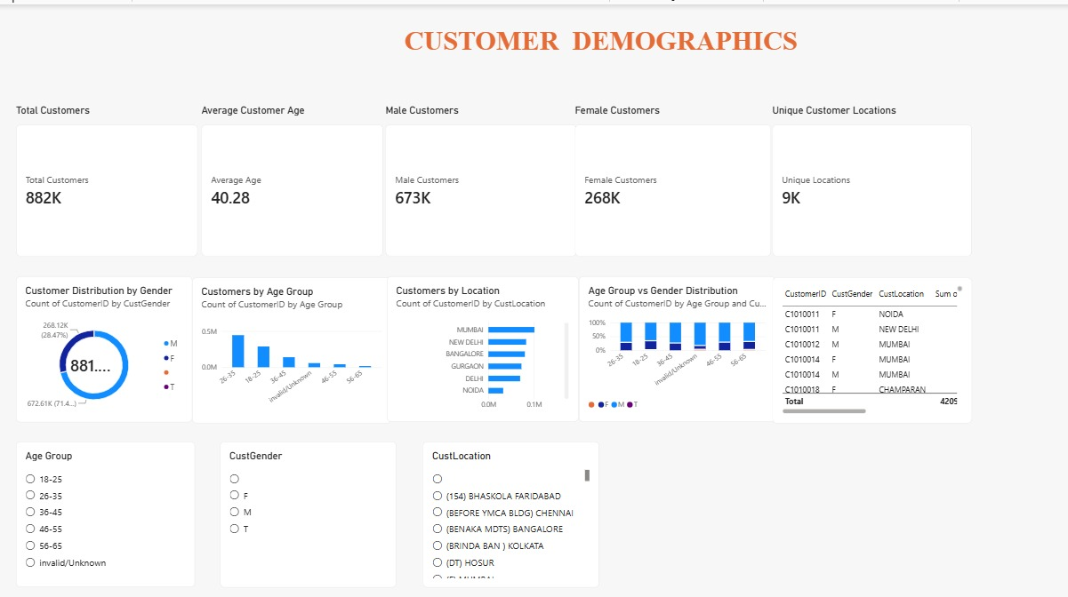
Exploratory Data Analysis

Slide 7
Explanation from Dashboard
The dashboard has 882K customers with an average age of 40.28 years.
There are 673K male and 268K female customers.
Customers are spread across around 9K locations.
The 26–35 age group has the highest number of customers.
Mumbai, New Delhi, Bangalore, Gurgaon, Delhi, and Noida are the major locations shown.
The dashboard allows filtering by Age Group, Gender, and Location.

Slide 8
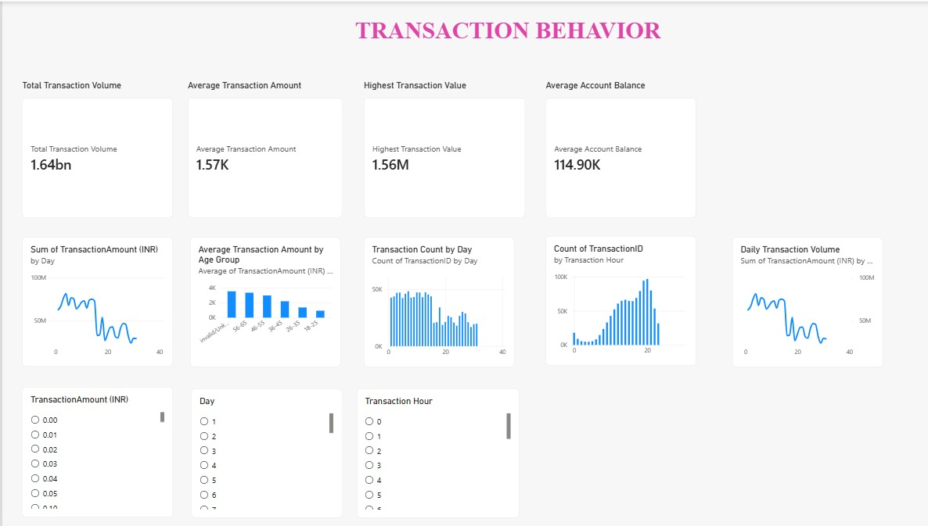

Slide 9
Explanation From Dashboard
The dashboard shows a total transaction volume of ₹1.64 billion, representing the
overall value of all transactions.
The average transaction amount is ₹1.57K, showing the typical value of a transaction.
The highest transaction value is ₹1.56 million, indicating the largest individual transaction.
The average account balance is ₹114.90K, representing the average balance maintained by customers.
Transaction activity varies across different days, with some days recording higher transaction
volumes than others.
Transaction activity also changes by hour, showing when customers are more active in making transactions.

Slide 10
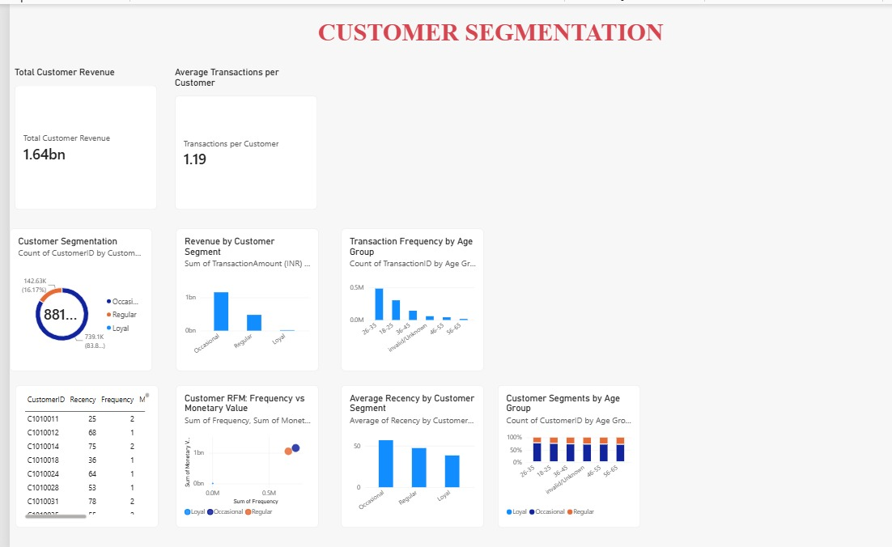

Slide 11
Explanation from dashboard
The dashboard shows total customer revenue of ₹1.64 billion.
Customers make an average of 1.19 transactions per customer.
The customer base is divided into Occasional, Regular, and Loyal segments,
with Occasional customers forming the largest group.
Occasional customers contribute the highest revenue, followed by Regular
and Loyal customers.
Transaction frequency is highest among the 26–35 age group, with RFM analysis showing
the relationship between customer frequency and monetary value.

Slide 12
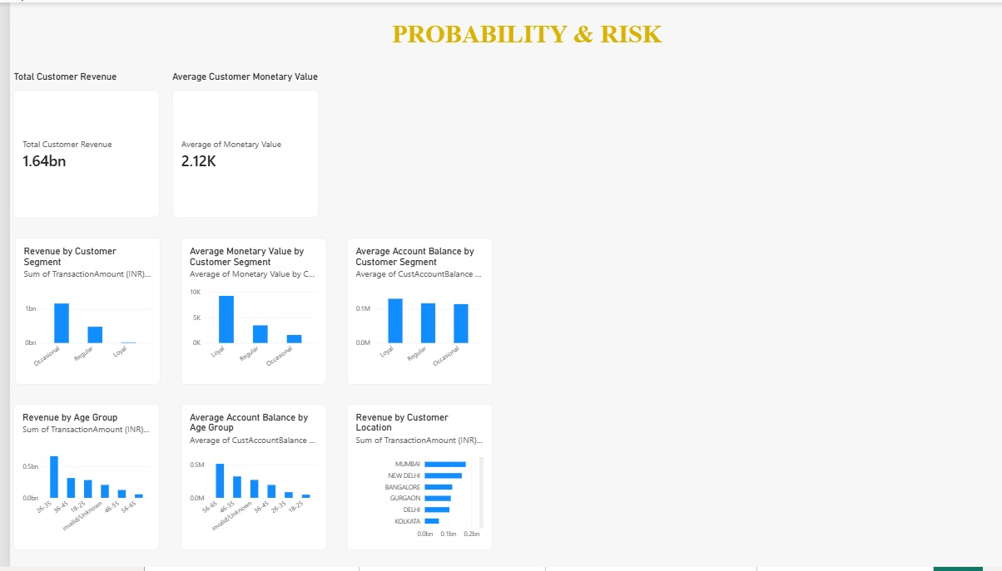

Slide 13
Explanation from Dashboard
The dashboard shows total customer revenue of ₹1.64 billion and an average customer
monetary value of ₹2.12K.
Occasional customers generate the highest total revenue, followed by Regular and Loyal customers.
Loyal customers have the highest average monetary value, compared with Regular and Occasional customers.
The 26–35 age group contributes the highest revenue, while account balances vary across different age groups.
Mumbai, New Delhi, Bangalore, Gurgaon, Delhi, and Kolkata are among the locations contributing significant customer revenue.

Slide 14
CONCLUSION
The Bank Customer Segmentation project provides a clear understanding of customer demographics, transaction behavior, and spending patterns. The analysis segments customers into Occasional, Regular, and Loyal groups and uses RFM analysis to understand their transaction activity and monetary value. The dashboard also highlights differences in revenue across age groups, customer segments, and locations, providing useful insights into overall customer behavior and profitability.

Slide 15

THANK
YOU

